Slide 1




FOREIGN DIRECT INVESTMENT ANALYSIS
Detailed Project Report
Moin khan

Slide 2





OBJECTIVE
The goal of this project is to understand the Foreign direct investment in India for the last 17 years from 2000-01 to 2016-17.

Slide 3












PROBLEM STATEMENT
Investment is a game of understanding historic data of investment objects under different events but it is still a game of chances to minimize the risk we apply analytics to find the equilibrium investment.
To understand the Foreign direct investment in India for the last 17 years from 2000-01 to 2016-17. This dataset contains sector and financial year-wise data of FDI in India
Sector-wise investment analysis
Year-wise investment analysis

Slide 4



ARCHITECTURE
Real World
Data Pre-Processing
Raw Data Collection
Importing Libraries in Jupyter Notebook
Load Dataset
Missing Value Imputations
Handling Outliers
Data Cleaning
Deployment
Insights
Power BI Desktop
Modelling
Exploratory Data Analysis (EDA)
Reporting
Detailed Project Report

Slide 5





DATASET INFORMATION
This dataset contains sector-wise and financial year- wise data of FDI in India

Slide 6
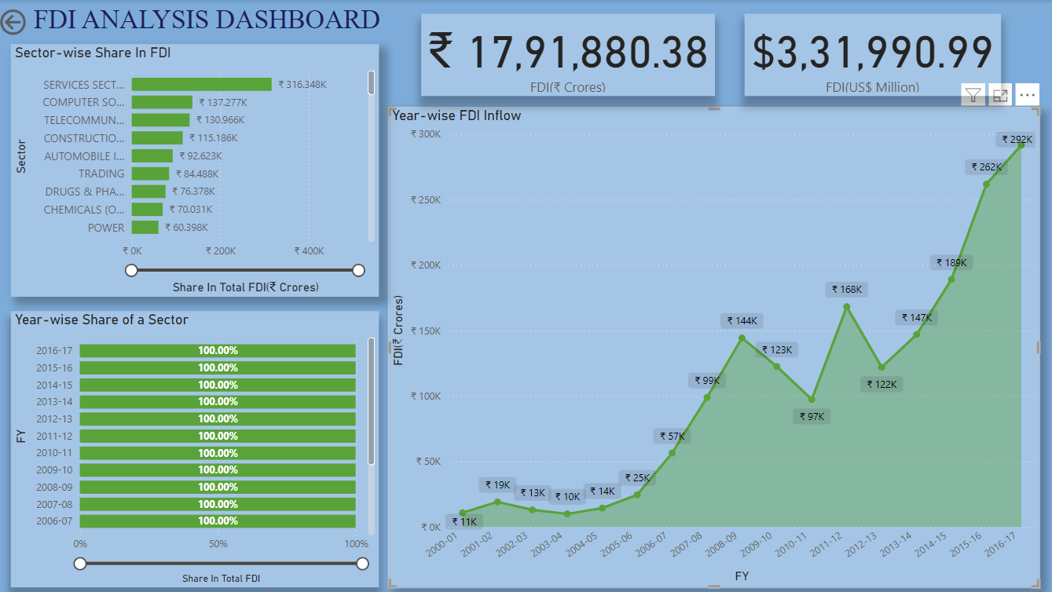
Service Sector received around ₹316kCr FDI from FY 2000-01 to FY 2016-17 which was the
highest, details regarding other sectors are also available.
From the Line-chart we can see the trend of FDI Inflow.

Slide 7
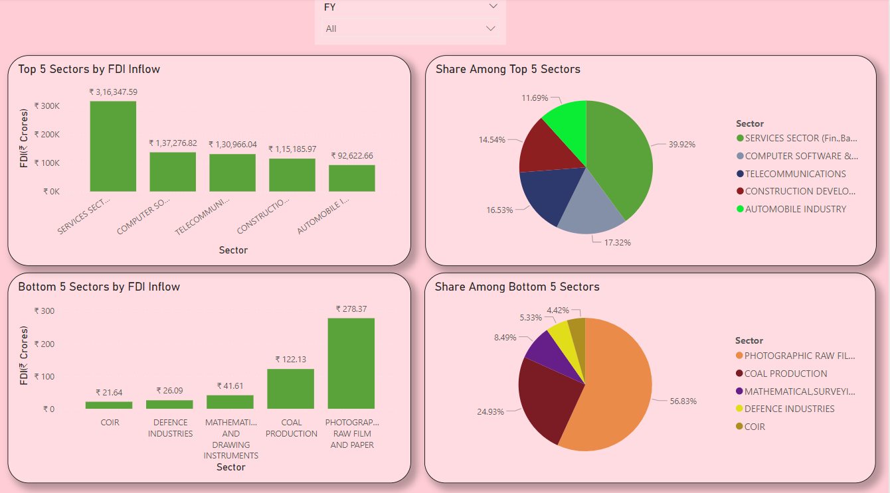
Among Top 5 Sectors Service sector has the highest FDI inflow having 39.92%, followed by the Computer Software and Hardware, Telecommunication,
Construction development, Automobile Industry sector having 17.32%, 16.53 %, 14.54%, 11.69% respectively.
Among Bottom 5 Sectors COIR has the lowest FDI Inflow 4.42%, followed by Defence Industries, (Mathematical, surveying and Drawing instruments), Coal Production, Photographic raw film and paper sector having 5.33%, 8.49%, 24.93%, 56.83%.

Slide 8
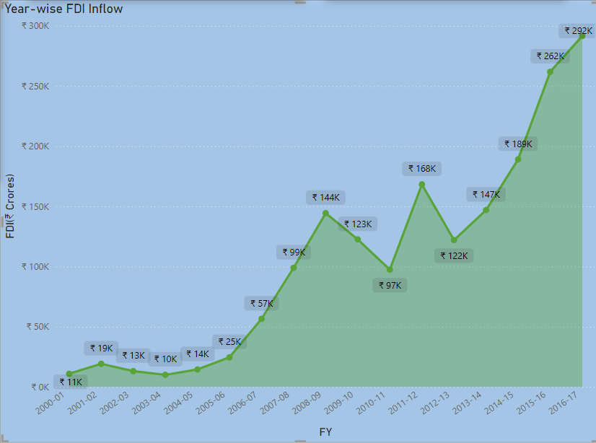
The above chart shows the total amount of FDI inflows in India during the last 17 years. The FDI inflow from 2000-2001 i.e.
₹10.87kCr. in 2001-02 it was ₹19.21kCr.
It shows a Good result in the FDI inflows in India. Little bit ups and downs in FDI inflows, but after that great hike in the year 2007-08.
In 2008-2009 there was a huge investment in FDI in ₹144.39kCr and so on. But again there were some fluctuations in the inflow of FDI in the years between 2010-2014, soon giving the highest figures in the last 17 years ₹291.61kCr FDI in 2016-2017 So we can say that the foreign investors have been on rising in India.

Slide 9




















CONCLUSION
SECTORAL COMPOSITION OF FDI:-
The Sectoral composition of FDI over the period of April 2000 to June 2017, we can find that the largest recipient of such investment is Service sector (Financial and non-financial services). The share of this sector comparing to all sector is 17.65 % of the inflow total foreign direct investment.
The foreign investors are interested in mainly financial services due to its profit generating advantage. This sector gives scope for the foreign investor to take back the profits to the home country. As service sector the services are consumed in the host country and there by generating outflow of funds from the host country.
The second recipient is Computer software and Hardware sector which shares 7.66% of total FDI. Construction development,
Telecommunication, Automobile Industry sector having 7.31%, 6.43%, 5.17% respectively.
The keys takeaways regarding global flows are – the increase in the relative share of developing countries as both destination and sources and flow to the sector gaining over manufacturing.
FY-wise GROWTH ANALYSIS:-
India's total amount of FDI inflow during 17 years, i.e. 2000 to 2017. The FDI inflow from 2000-2001 i.e. 10.87kCr in 2001-02 it was 19.21kCr. It shows a Good result in the FDI inflows in India. A little bit of ups and downs in FDI inflows up to 2005-06 but after that great hike in the year 2007-08 i.e. 98.94kCr as compared to earlier years. In 2008-2009 there was a huge investment in FDI in 144.39kCr.
But then there was a downfall in the Inflow of FDI in two consecutive years 2009-2010 and 2010-2011, with figures 122.56kCr and
97.42kCr respectively. We can Analyse from the graph that in the year 2015-2016 the inflow of FDI was second highest of last 17
years i.e. 261.85kCr. In the year 2012-13 and 2013-14 the FDI inflow fluctuated from 121.98kCr to 147.01kCr respectively. In the last Financial Year i.e. 2016-2017 the amount of FDI Inflow were 291.61kCr which is the highest FDI inflow in the last 17 years.

Slide 10
THANK YOU

